Slide 1

CSE- AI & DS
Unit-2
Software Project Management
Prof. Deepak Palavalasa
Assistant Professor
AI&DS Department

Slide 2
Contents- Software Testing
Software Project Management:
Management Spectrum, People, Product, Process- Project
W5HH Principle, Importance of Team Management
Planning a Software Project :
Scope and Feasibility
Effort Estimation, Schedule and staffing, Quality Planning
Risk management- identification,assessment, control, project monitoring plan, Detailed Scheduling

Slide 3
Management Spectrum
CSE- AI & DS
Software Project Management revolves around 4 main elements:
  People
  Product
  Process
  Project

Slide 4
Management Spectrum
CSE- AI & DS
People
People are the most important part of any software project.
Their skills, communication, teamwork, and responsibility for project success.
People include developers, testers, analysts, designers, project managers, etc.
Product
The product refers to the actual software being developed and its features, functions, constraints, and requirements.
Real-Time Example: Product = Online Shopping Website
Features include:
User Login
Product Search
Add to Cart

Slide 5
Management Spectrum
Process
Process defines the steps, methods, and models used for development (Agile, Waterfall, Spiral). It ensures disciplined and structured work.
Project
A project includes planning, scheduling, budgeting, risk handling, monitoring, and delivering the product on time.
Real-Time Example:
Developing a Banking App with phases:
Requirement Analysis – 2 weeks
UI Design – 1 week
Development – 8 weeks
Testing – 3 weeks
Deployment – 1 week

Slide 6
W5HH Principle
CSE- AI & ML
A project planning technique to answer important questions:
Why is the project being done?
What will be done?
When will it be completed?
Who will do it?
Where will development happen?
How will it be done?
How much will it cost?

Slide 7
W5HH Principle
CSE- AI & ML
Real-time Example:
Project: Building an Online Learning Platform
Why: To provide video classes to students
What: Video lessons, tests, tracking progress
When: 6 months
Who: 1 PM, 6 developers, 2 testers
Where: Hybrid (office + remote)
How: Using MERN stack + Cloud
How much: ₹25–30 lakhs

Slide 8
W5HH Principle
CSE- AI & ML
Project: Building a Banking Mobile App
Why:
To provide customers secure online banking services
Reduce branch visits & improve convenience
What:
Account balance, statements
Money transfer (IMPS/NEFT/RTGS/UPI)
Bill payments
Card management
Notifications & alerts

Slide 9
W5HH Principle
CSE- AI & ML
When:
8 months
Who:
1 PM
6 Developers
3 Testers
1 UI/UX designer
1 Cybersecurity specialist
Where:
Hybrid (office for secure tasks + remote coding)

Slide 10
W5HH Principle
CSE- AI & ML
How:
Tech: Flutter/React Native, Node.js/Spring Boot, PostgreSQL
Cloud deployment (AWS/Azure)
High-security encryption + MFA
How much:
₹40–50 lakhs

Slide 11
Project Scope and Feasibility
CSE- AI & ML
Project scope defines:
What the project will deliver (software features, modules, outputs)
What is NOT included
Overall boundaries, constraints, assumptions
Key Components of Scope
Business Requirements
Functional Scope
Non-Functional Scope
Technology and Platform
Constraints (Time, Budget, Tools, Regulations)
Assumptions

Slide 12
Project Scope and Feasibility
CSE- AI & ML
Example – Food Delivery App (like Swiggy/Zomato)
In Scope
User registration/login
Browse restaurants and menus
Cart & online payment
Order tracking
Admin dashboard

Slide 13
Feasibility Analysis
CSE- AI & ML
Project Feasibility means checking whether a project can be done successfully with the available time, money, resources, technology, and skills.
It helps decide if the project is realistic, practical, and worth doing.

Slide 14
Feasibility Analysis
CSE- AI & ML
Example 1: Building a Mobile App
Before creating a mobile app, you check:
Do we have skilled developers? (Technical feasibility)
Do we have enough budget? (Economic feasibility)
Can it be completed in 3 months? (Schedule feasibility)
Is it allowed by law? (Legal feasibility)
If all answers are YES → the project is feasible.
If not → the project may fail.

Slide 15
Effort Estimation
CSE- AI & ML
Effort estimation predicts:
How much work is required
How many people are needed
How long the project will take

Slide 16
Popular Estimation Techniques
CSE- AI & ML
1. Expert Judgment
Based on senior developers or architects' experience
Example: “This login module will take around 3 days based on previous projects.”
2. Work Breakdown Structure (WBS)
Break project into small tasks → estimate each.
Example – E-commerce Website
UI Design – 40 hours
Backend APIs – 120 hours
Database design – 20 hours
Testing – 50 hours

Slide 17
Popular Estimation Techniques
CSE- AI & ML
3. Use Case Point (UCP)
Based on complexity of use cases.
Example:
Login (simple), Payment (complex), Order tracking (medium)
4. Function Point Analysis (FPA)
5. COCOMO Model (Constructive Cost Model)

Slide 18
COCOMO Model (Constructive Cost Model)
CSE- AI & ML
COCOMO is a software estimation model developed by Barry Boehm used to estimate:
Effort (person-months)
Development time (schedule)
Staffing
Project cost
COCOMO uses the size of the software (measured in KLOC = Thousands of Lines of Code) to determine the effort required.

Slide 19
COCOMO Model (Constructive Cost Model)
CSE- AI & ML
Types of COCOMO
Type | Description
Basic COCOMO | Estimates effort based only on size (KLOC)
Intermediate COCOMO | Considers size + cost drivers
Detailed COCOMO | Considers size + cost drivers + phase-wise distribution

Slide 20

Basic COCOMO Model Formula
CSE- AI & ML
Effort (E)
$$\text{Effort}\text{ = }\text{a}\text{1 }\text{∗ }\text{(}\text{KLOC}\text{)^}\text{a}\text{2 }\text{PM}$$
E → Effort in Person-Months
KLOC → Thousands of Lines of Code
a1, a2 → constants based on project type
Development Time (D)
$$\text{Tdev}\text{ = }\text{b}\text{₁ }\text{×}\text{ (}\text{Effort}\text{)^}\text{b}\text{2 }\text{Months}$$
Tdev is the estimated time to develop the software, expressed in months b1, b2 → constants based on project type
Staffing (P)
$$P=\frac{E}{D}$$

Slide 21
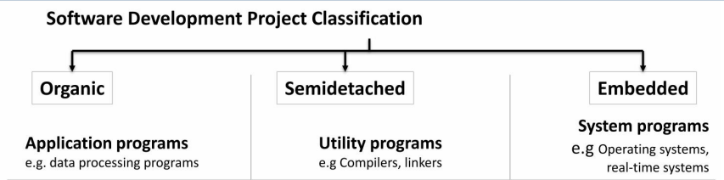
Software Development Project
CSE- AI & ML

Slide 22
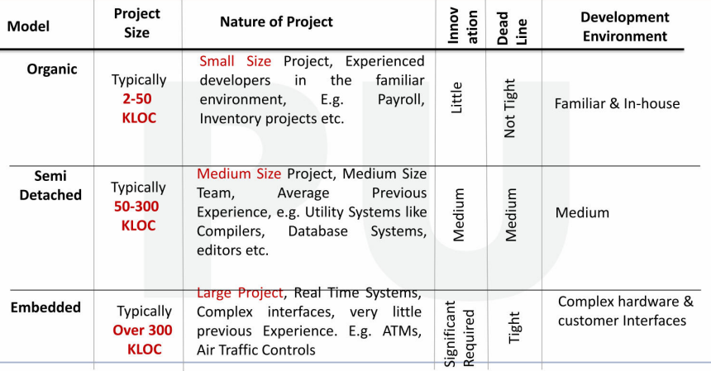
Software Development Project
CSE- AI & ML

Slide 23
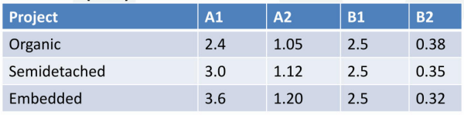
Basic COCOMO Model Formula
CSE- AI & ML
Project Types and Constants

Slide 24

Real-Time Example – Basic COCOMO
CSE- AI & ML
Project: Online Ticket Booking Website
Estimated Size: 50 KLOC
Project Type: Organic
Step 1: Calculate Effort
$$E=2.4×\left(50{\left.)\right.}^{1.05}\right.$$
Compute:
$${50}^{1.05}≈60.8$$
$$E=2.4×60.8=1\text{46} \text{person}\text{−}\text{months}$$
Effort = 146 Person-Months

Slide 25
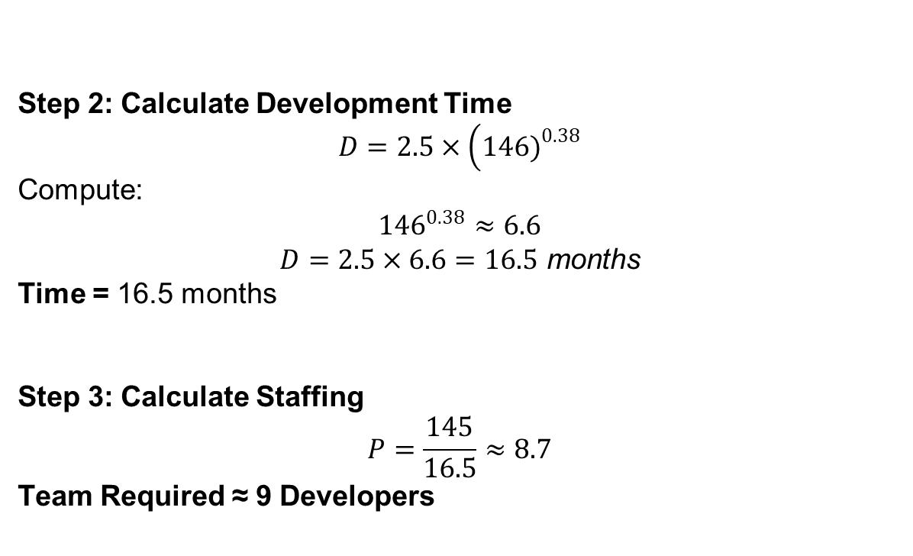
Real-Time Example – Basic COCOMO
CSE- AI & ML
Step 2: Calculate Development Time
$$D=2.5×\left(146{\left.)\right.}^{0.38}\right.$$
Compute:
$${146}^{0.38}≈6.6$$
$$D=2.5×6.6=16.5 \text{months}$$
Time = 16.5 months
Step 3: Calculate Staffing
$$P=\frac{145}{16.5}≈8.7$$
Team Required ≈ 9 Developers

Slide 26
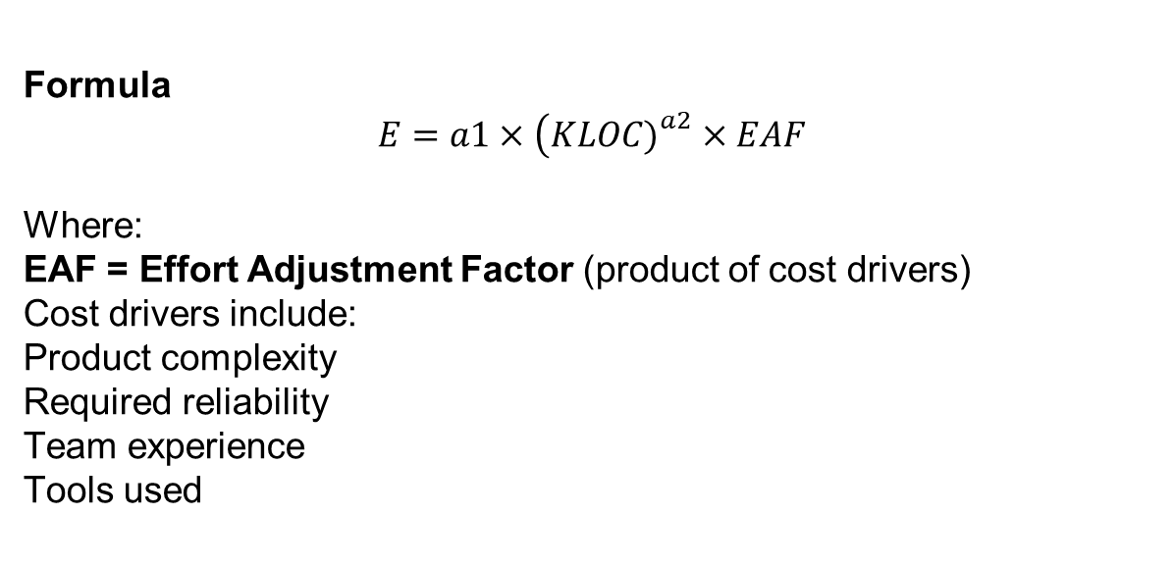
Intermediate COCOMO
CSE- AI & ML
Formula
$$E=a1×\left(KLOC{\left.)\right.}^{a2}×EAF\right.$$
Where:
EAF = Effort Adjustment Factor (product of cost drivers)
Cost drivers include:
  Product complexity
  Required reliability
  Team experience
  Tools used

Slide 27
Detailed / Complete COCOMO Model
CSE- AI & ML
The model incorporates all qualities of both Basic COCOMO and Intermediate COCOMO strategies on each software engineering process.
The whole software is divided into different modules, and then apply COCOMO in different modules to estimate effort and then sum the effort.

Slide 28
Detailed / Complete COCOMO Model
CSE- AI & ML
The Six phases of detailed COCOMO are:
Planning and requirements
System design
Detailed design
Module code and test
Integration and test
Cost Constructive model
(Useful for large enterprise-level projects like banking systems.)

Slide 29
FPA – Function Point Analysis
CSE- AI & ML
Function Point Analysis is a standard method to measure the functionality of software from the user’s perspective.
Unlike COCOMO, FPA does NOT depend on lines of code.
It measures:
Inputs
Outputs
User interactions
Files
External interfaces

Slide 30
FPA – Function Point Analysis
CSE- AI & ML
Why Do We Need FPA?
To Make Estimation Technology independent
To Measure Software Size
To Improve Estimation Accuracy
To Support Better Project Planning
With a clear size measure, teams can plan:
Effort, staffing, timelines, budgets
5. To Strengthen Requirement Understanding
FPA forces analysts to clearly identify:
inputs
Outputs
data stores
user interactions

Slide 31
FPA – Function Point Analysis
CSE- AI & ML
Elements Counted in FPA
Element | Meaning | Example
EI – External Inputs | Data entering system | Login form, registration, order entry
EO – External Outputs | Data leaving system | Reports, invoices, emails
EQ – External Queries | Input + output | Search feature
ILF – Internal Logical Files | Internal data tables | User table, product table
EIF – External Interface Files | Data from external systems | Payment gateway data

Slide 32
FPA Calculation Steps
CSE- AI & ML
Count Unadjusted Function Points (UFP)
Weight Table
1. External Inputs (EI)
2. External Outputs (EO)
3. External Queries (EQ)
Complexity | Weight
Low | 3
Medium | 4
High | 6
Complexity | Weight
Low | 4
Medium | 5
High | 7
Complexity | Weight
Low | 3
Medium | 4
High | 6

Slide 33
FPA Calculation Steps
CSE- AI & ML
Count Unadjusted Function Points (UFP)
Weight Table
4. Internal Logical Files (ILF)
5. External Interface Files (EIF)
Complexity | Weight
Low | 7
Medium | 10
High | 15
Complexity | Weight
Low | 5
Medium | 7
High | 10

Slide 34

Steps to Calculate– Function Point
CSE- AI & ML
Step 1: Calculate Unadjusted Function Points (UFP)
Item: Count*Complexity
$UFP=Sum of 5 items$
Step 2: Calculate Value Adjustment Factor (VAF)
Step 3: Calculate VAF
$$VAF=0.65+\left(0.01×\text{GSC}\right)$$
Step 4: Calculate Final Function Points (FP)
$$FP=UFP×VAF$$

Slide 35
Real-Time Example – Function Point Calculation
CSE- AI & ML
Project: Online Shopping Website
Given Counts
Item | Count | Complexity
External Inputs (EI) | 10 | Medium
External Outputs (EO) | 6 | High
External Queries (EQ) | 8 | Low
ILF | 4 | Medium
EIF | 3 | Low

Slide 36

Real-Time Example – Function Point Calculation
CSE- AI & ML
Step 1: Calculate UFP
              EI: 10 inputs × weight 4 = 40
              EO: 6 outputs × weight 7 = 42
              EQ: 8 queries × weight 3 = 24
              ILF: 4 files × weight 10 = 40
              EIF: 3 files × weight 5 = 15
Total UFP
$$UFP=40+42+24+40+15=161$$

Slide 37
Real-Time Example – Function Point Calculation
CSE- AI & ML
Step 2: Calculate Value Adjustment Factor (VAF)
There are 14 General System Characteristics (GSCs):
Data communications
Performance
Transaction rate
Reusability
Security
Complex processing
Distributed processing
User efficiency
Backup & recovery
Data complexity
Maintainability
Training
Installation
On-line data entry
Each is rated 0–5 Suppose total GSC score = 40

Slide 38
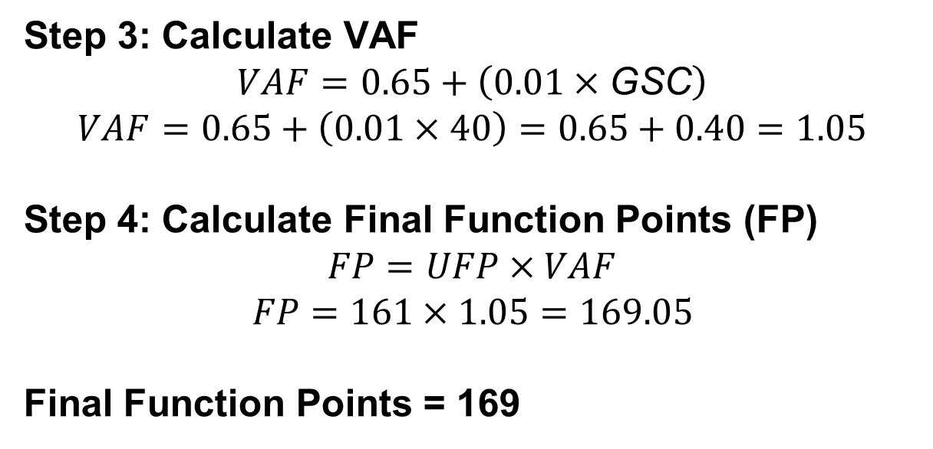
Real-Time Example – Function Point Calculation
CSE- AI & ML
Step 3: Calculate VAF
$$VAF=0.65+\left(0.01×\text{GSC}\right)$$
$$VAF=0.65+\left(0.01×40\right)=0.65+0.40=1.05$$
Step 4: Calculate Final Function Points (FP)
$$FP=UFP×VAF$$
$$FP=161×1.05=169.05$$
Final Function Points = 169

Slide 39
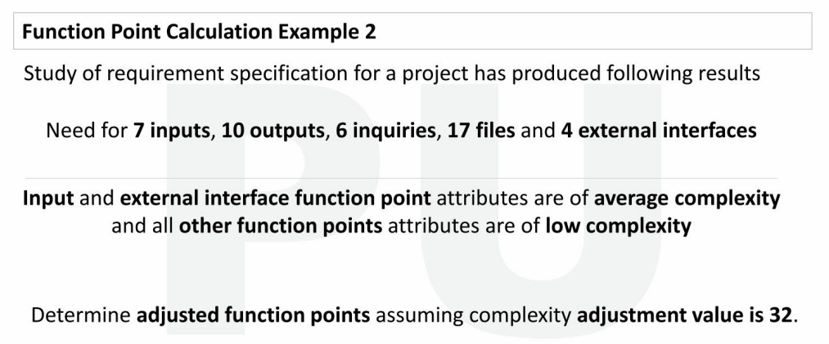
Real-Time Example – Function Point Calculation
CSE- AI & DS

Slide 40
Real-Time Example – Function Point Calculation
CSE- AI & DS
1. Identify function types and complexities
You’re given:
Inputs (EI) = 7 → Average complexity
Outputs (EO) = 10 → Low complexity
Inquiries (EQ) = 6 → Low complexity
Files (ILF) = 17 → Low complexity
External Interfaces (EIF) = 4 → Average complexity

Slide 41
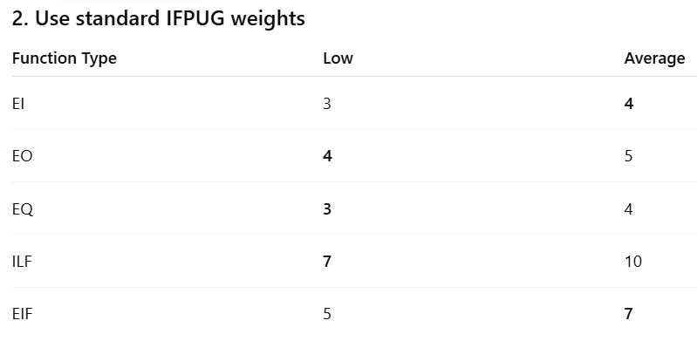
Real-Time Example – Function Point Calculation
CSE- AI & DS

Slide 42
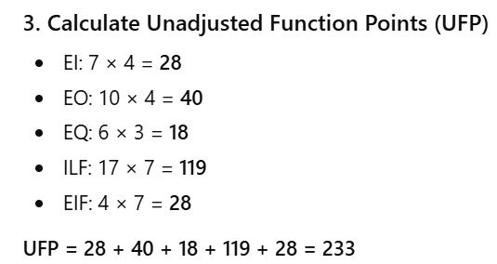
Real-Time Example – Function Point Calculation
CSE- AI & DS

Slide 43
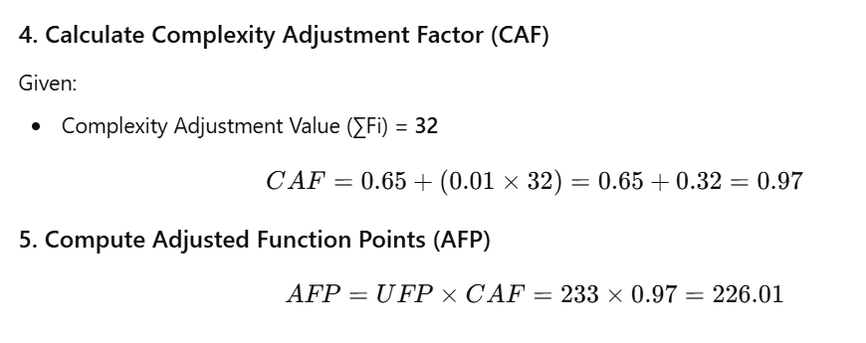
Real-Time Example – Function Point Calculation
CSE- AI & DS

Slide 44
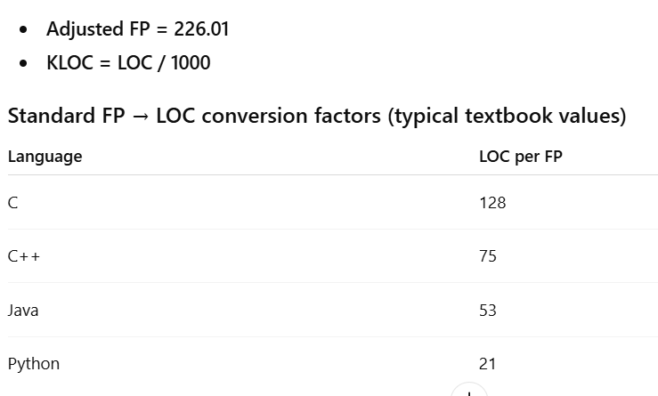
Real-Time Example – Function Point Calculation
CSE- AI & DS

Slide 45
Real-Time Example – Function Point Calculation
CSE- AI & DS
LOC Calculations in Different Programming Languages
C
LOC = 226.01 × 128 = 28,929.28 LOC
KLOC = 28.93
C++
LOC = 226.01 × 75 = 16,950.75 LOC
KLOC = 16.95
Java
LOC = 226.01 × 53 = 11,978.53 LOC
KLOC = 11.98
Python
LOC = 226.01 × 21 = 4,746.21 LOC
KLOC = 4.75

Slide 46
Project Scheduling & Tracking
CSE- AI & DS
Scheduling Principles
Compartmentalization
Interdependency
Time Allocation
Effort Validation
Define Responsibilities
Define Outcomes
Define Milestones

Slide 47
Project Scheduling & Tracking
CSE- AI & DS
Compartmentalization
Breaking a project into smaller, manageable parts.
Example: Dividing a software project into modules like login, dashboard, and reports.
Interdependency
When one task or module depends on another to function or complete.
Example: The payment module depends on the user authentication module.

Slide 48
Project Scheduling & Tracking
CSE- AI & DS
Time Allocation
Assigning a fixed amount of time to each project activity.
Example: Allocating 2 weeks for design and 3 weeks for coding.
Effort Validation
Checking whether the estimated effort matches the actual work done.
Example: Comparing planned 100 hours of coding with actual hours spent.
Define Responsibilities
Clearly assigning tasks to specific team members.
Example: One developer handles backend, another handles frontend.

Slide 49
Project Scheduling & Tracking
CSE- AI & DS
Define Outcomes
Clearly stating what result is expected from a task or phase.
Example: Outcome of testing phase is a bug-free, stable software build.
Define Milestones
Setting key checkpoints to track project progress.
Example: Completion of design document by the end of week 2.

Slide 50
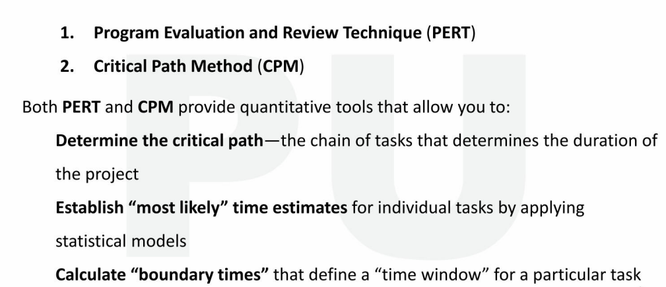
Scheduling methods
CSE- AI & DS

Slide 51
Effort Distribution
CSE- AI & DS
General guideline: 40-20-40 rule
40% or more of all effort allocated to analysis and design tasks
20% of effort allocated to programming
40% of effort allocated to testing, Deployment & Maintenance
Although most software organizations encounter the following projects types:
Concept Development
New Application Development
Application Enhancement
Application Maintenance
Reengineering

Slide 52
Risk analysis & Management
CSE- AI & DS
Risk Analysis and Risk Management are systematic processes used to identify, assess, and control threats that could negatively impact an organization, project, or system.
These threats may come from financial uncertainty, legal liabilities, strategic failures, natural disasters, or cybersecurity incidents.

Slide 53
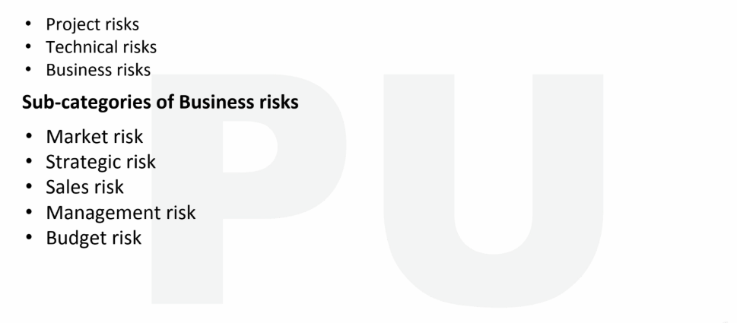
Predictable Risk Categories
CSE- AI & DS

Slide 54
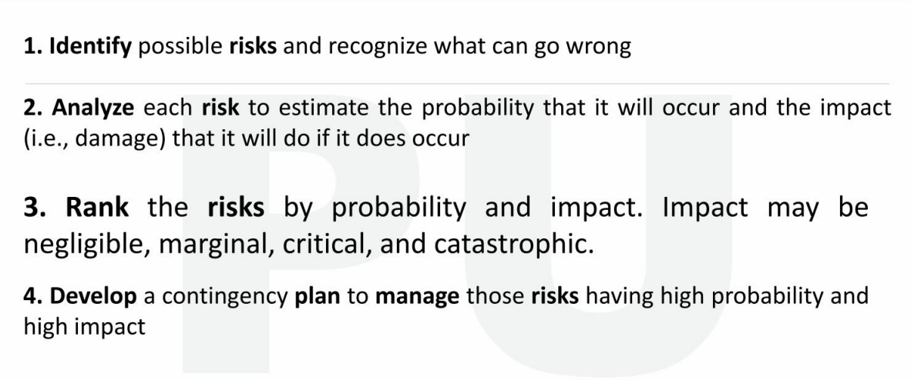
Steps for Risk Management
CSE- AI & DS

Slide 55
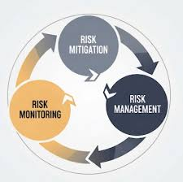
RMMM
CSE- AI & ML
RMMM - Mitigation, Monitoring, and Management
An effective strategy for dealing with risk must consider three issues
Risk mitigation (i.e., avoidance, try to stop the risk or reduce its effect)
Risk monitoring
Risk management (Handle the risk if it actually happens)

Slide 56
RMMM
CSE- AI & DS
Risk Mitigation
Actions taken in advance to reduce the probability or impact of a risk.
Goal: Prevent the risk or reduce its damage
Risk Monitoring
Continuous tracking of identified risks to detect early warning signs.
Goal: Know when a risk is about to happen
Risk Management
Actions taken when a risk occurs (contingency plans).
Goal: Control damage and recover quickly

Slide 57
Risk Estimation
CSE- AI & DS
Risk estimation is a part of risk assessment that measures the probability and impact of identified risks to determine their severity. It provides a numerical or qualitative value to express how serious a risk is.
Uses descriptive scales.
Common Scale
Likelihood: 1 (Low) to 3 (High)
Impact: 1 (Low) to 3 (High)
Risk Score = Likelihood × Impact

Slide 58
Risk Estimation
CSE- AI & DS
Likelihood | Description
1 | Unlikely
2 | Possible
3 | Likely
Impact | Description
1 | Minor
2 | Moderate
3 | Major

Slide 59
Risk Estimation
CSE- AI & DS
Example (Qualitative)
A data breach risk:
Likelihood = 3
Impact = 3
Calculate the Risk and say the risk is High or Low

Slide 60


www.paruluniversity.ac.in

